Slide 1
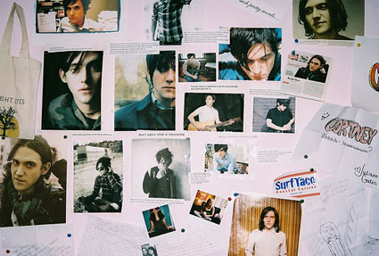
Conor Oberst
By Michelle Roberts

Slide 2
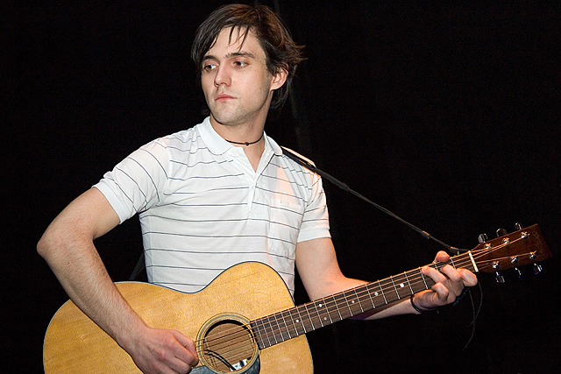
Conor Mullen Oberst, born February 15th 1980 in Omaha, Nebraska.
indie, folk, alternative.

Slide 3
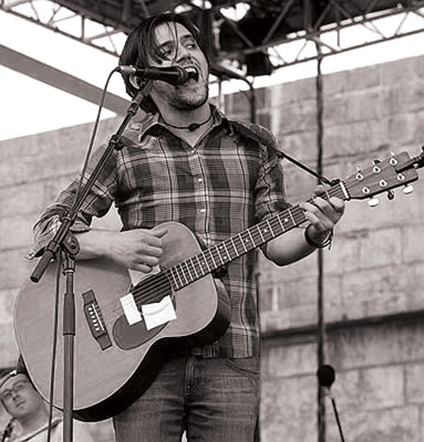
The start of his musical career
He started banging on the piano when he was two and his dad started teaching him to play guitar when he was ten. He went to St. Leo School when he was 13 and was a part of the schools choir and other musical groups.

Slide 4
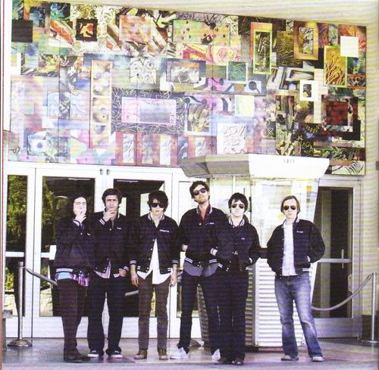
Bands he has been apart of….
Bright Eyes, Conor Oberst and the Mystic Valley Band ,Commander Venus, The Magnetas, Park Ave., Norman Bailer (The Faint), Desaparecidos, and Monsters of Folk.
He is also co-owner of Saddle Creek Records with his brother Justin.

Slide 5
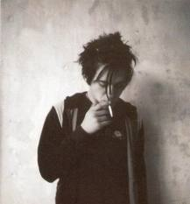
His first break!
Musical influences
1992,Ted Stevens from Mayday and Cursive invited Conor to play with them. Bill Hoover saw him playing and a few weeks later Conor got invited to play with him, thus writing enough songs for the set and establishing him as a musician.
his older brother and parents who introduced him to music. The musicians/songwriters Simon Joyner and David Dondero. folk revival, Neil Young, Leonard Cohen, and country singers Emmylou Harris, John Prine and Townes Van Zandt. Daniel Johnston and Elliot Smith were also big influences.

Slide 6
Four Winds Listening Guide
at 0:10 it opens with a fiddle and drums. You can hear the acoustic Guitars, Keyboards, Violin, Bass, and Vocals.
at 0:37 there's a cadence indicating the end of a phrase
Indie folkish vibe
0:52 the pitch goes up
1:12 the fiddle returns as a strong sound
the rhythm stays constant through out the song
1:14 you can hear some guitar finger picking
the drums are keeping the beat
1:55 the pitch goes up again and the vocals quiver
2:17 is the start of another cadence
the is very upbeat but gets quieter at 2:31
2:43 the beat rises
At 3:00 multiple voices
it concludes with Conors voice quieting with the music
Written by Conor Oberst . Released on March 6, 2007 with his band Bright Eyes on the Cassadaga album. And was ranked #5 on Rolling Stone's list of the 100 Best Songs of 2007.

Slide 7
Sausalito Listening Guide
Composed of Nik Freitas and Taylor Hollingsworth on guitar, Macey Taylor on bass, Nate Walcott on keyboards and organ and Jason Boesel ondrums.
starts with an interesting beat; sounds like with acoustic guitars
With his Mystic Valley band on the Album Cape Canaveral in 2008
rhythm stays constant till 0:37 then goes back to its normal
changes again at 0:54
1:02 his voice gets calmer
1:07 voice and beat ascends to the chorus
1:30 cadence between a voice change
also has a folky beat
2:26 chorus
2:48 small guitar solo
the tempo speeds up and slows down to an end

Slide 8
Milk Thistle Listening Guide
sounds like its starts with an acoustic guitar with specific fingerpicking
calmer song with a slow beat
1:26 his voice decends
1:33 you can hear each note on the guitar getting a deeper sound
this songs volume is very quiet and is silent at some points. Showing the organization between sound and silence
40-30 decibals
2:15 the volume changes when he sings “going up and down”
2:22 almost silence
it has a very soft melody through out the song
3:00 very quiet
comes to a close with the same tone

Slide 9
Road to Joy Listening Guide
Genre: Folk Music Instruments Used: Conor Oberst – guitar, vocals Mike Mogis – 12-string guitar Nate Walcott – trumpet Clark Baechle – drums Matt Maginn – bass Alex McManus – guitar Nick White – organ begins with a finger picking section combined with an interpolation of the melody of Beethoven's Ode to Joy. As the song progresses, it builds into a march, with the introduction of trumpets and horns. Near the end, everything fades out as Oberst delivers the final verse, and then all of the instruments come in at once in a loud frenzy, and continue for about 30-45 seconds before fading out and ending the album. They end by smashing up their instruments. (wiki)

Slide 10
Nicorette Listening Guide
starts with a guitar then the drums start, then vocals
Folkish beat
1:55 all music stops so its just his voice
Then continues with the drums and guitars follow
1:58 the tempo increases
2:17 Freitas takes the vocals over
2:35 Nate Walcott starts on the keyboard
Conor Oberst and Nate Walcott take turns
2:55 higher tempo
3:10 Conor says a lyric-not singing
3:12 Taylor Hollingsworth starts a guitar solo
3:32 Freitas starts singing again

